Slide 1
Summary of modelling - and an example

Slide 2
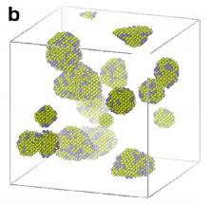
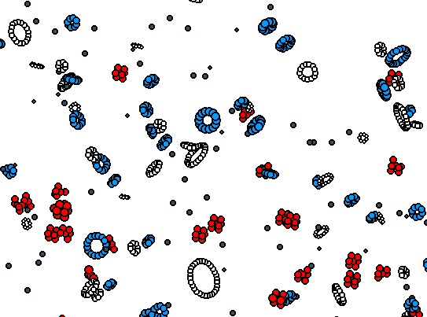
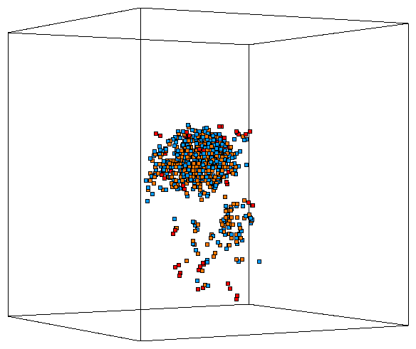
Radiation effects are inherently a multiscale problem
1 fs = 10⁻¹⁵ s
1-100 ps = 10⁻¹²- 10⁻¹⁰ s
ns = 10⁻⁹ s ….. ms = 10⁻³ s ….. 1 s …… 10³ s
Time scale
Displacement
Cascade
Precipitates
Loops & Cavities
Molecular dynamics
Atomistic KMC
From n spectrum to PKA & Displacement Cascade Spectrum
Incident particles
Nucleation &
Growth of
Precipitates &
Large Clusters
Relaxation
Thermal spike
Collisions
Secondary
Defect
Formation
Defect
Migration
Length scale
10s of nm = 10⁻⁸ m
100s of nm = 10⁻⁷ m

Slide 3
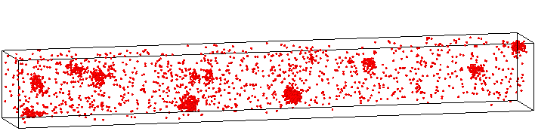
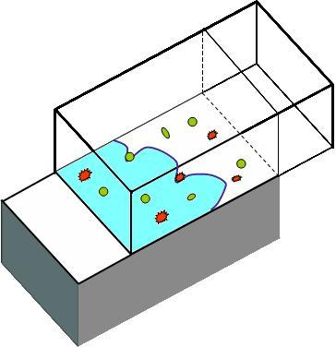
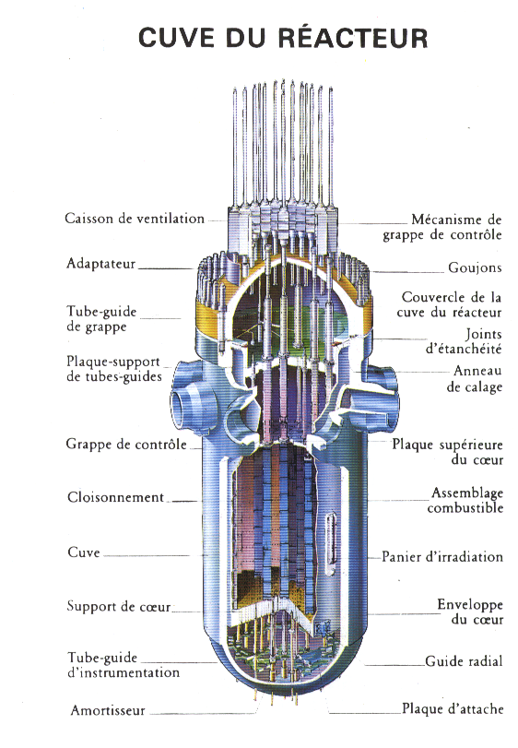
Radiation effects are inherently a multiscale problem
μs = 10⁻³ s.........................…………………….…… Years = 10⁷ - 10⁹ s
Time scale
Object KMC, rate theory
Growing Concentration of Radiation Induced Defects
while the Irradiation Proceeds
applied shear
pinned dislocation
Mechanical
Property Changes
Bridge to crystal plasticity
Dislocation dynamics
Increasing dose
Component lifetime management
Dislo/Defect Interaction
Yield Strength Increase
Loss of ductility
Stress
Length scale
Strain (%)
10s of μm = 10⁻⁵ m
cm = 10⁻² m

Slide 4
Modern approaches to materials modelling
Nanostructure and microchemical evolution models
Validation
Detailed Microstructural Examination
MODEL
Phenomena, Mechanisms
Conceptual model
Interpretation
Mechanisms and additional parameters
DFT
Energy parameters
Molecular dynamics or other atomistic simulations
Interatomic Potential

Slide 5
An example of bottom-up understanding

Slide 6
Atomic-level models show that 1D-migrating SIA clusters are slowed down in Fe-Cr alloys
600 K
ln(D^{SIA cluster}_{FeCr}/D^{SIA cluster}_{Fe})
Slowing down is a non-monotonic function of Cr concentration

Slide 7
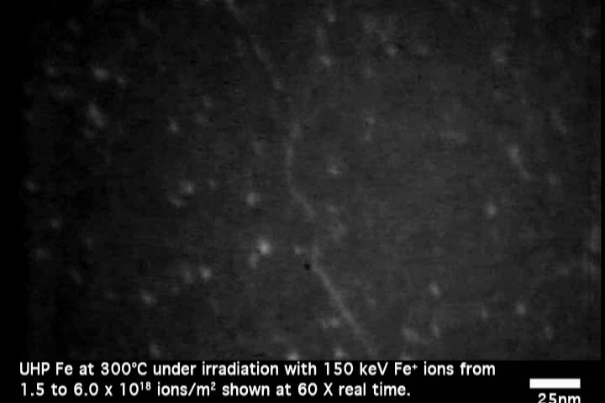
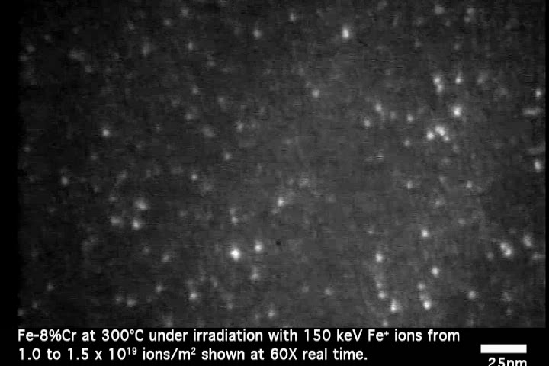
Electron microscopy confirms loop slowing down
Fe irradiated with ions at 300°C: loops are formed, move and disappear to the surface
←
Fe8%Cr irradiated with ions at 300°C: loops are formed, but move much less and accumulate
→
Courtesy of M. Hernàndez Mayoral, CIEMAT

Slide 8
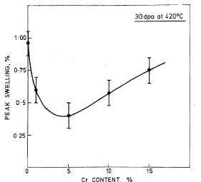
Swelling is a non-monotonic function of %Cr, too
600 K
ln(D^{SIA cluster}_{FeCr}/D^{SIA cluster}_{Fe})
Little & Stow JNM, 87 (1979) 25
Reduced SIA cluster mobility, especially 1D migrating
Reduction of swelling
Enhanced recombination with Cr-unaffected vacancies

Slide 9
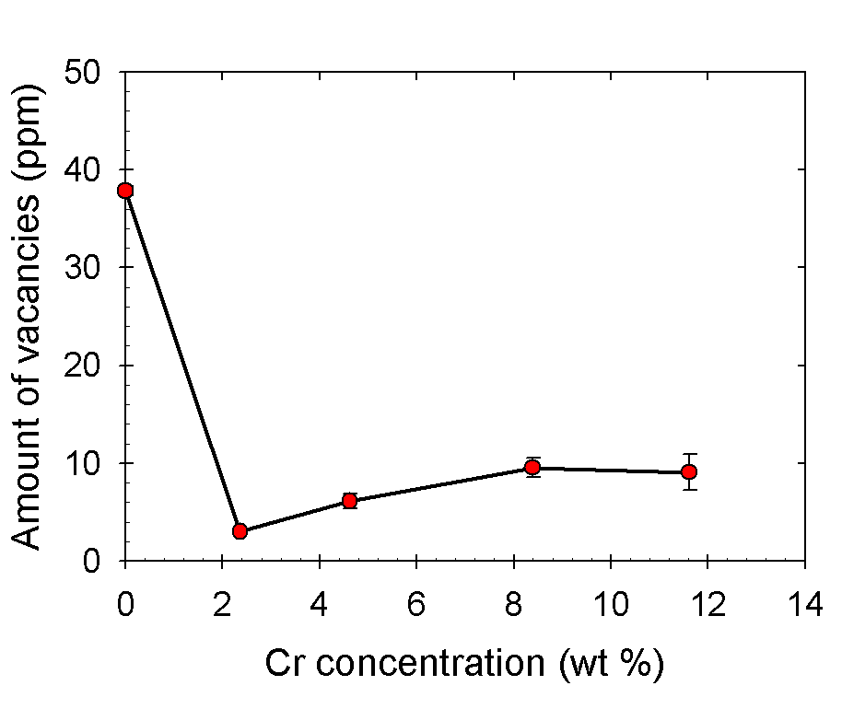
Enhanced recombination proven by positron annihilation spectroscopy
Lambrecht, PhD thesis, 2009
0.06 dpa
Positron annihilation studies show that total amount of vacancies in n-irradiated FeCr alloys decreases with Cr content
Fe
vacancy
SIA cluster

Slide 10
Enhanced recombination proven by positron annihilation spectroscopy
Lambrecht, PhD thesis, 2009
0.06 dpa
Positron annihilation studies show that total amount of vacancies in n-irradiated FeCr alloys decreases with Cr content
FeCr

Slide 11
Enhanced recombination proven by positron annihilation spectroscopy
Lambrecht, PhD thesis, 2009
0.06 dpa
Positron annihilation studies show that total amount of vacancies in n-irradiated FeCr alloys decreases with Cr content
These mechanisms, when properly parameterised, can be introduced in a rate theory or in kinetic Monte Carlo model which should provide a quantitative prediction of the actual concentration of point-defects and their clusters

Slide 12
However, the comparison between models and experiments is not always easy …

Slide 13



“Experimental validation”
Build a picture: Simulation results
Monte Carlo result
Atomistic results
Assumptions
?

Slide 14

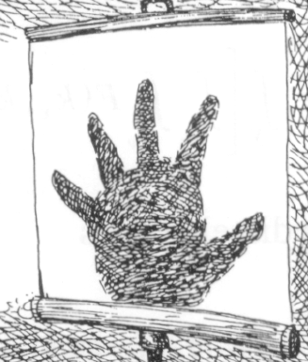


“Experimental validation”
Build a picture: Experimental result
???

Slide 15
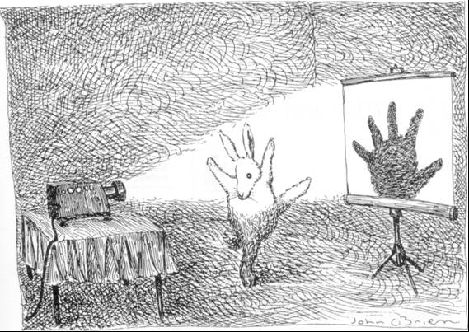
“Experimental validation”
God-like view

